Slide 1
QUANTIFY CHANCE
Combinations

Slide 2
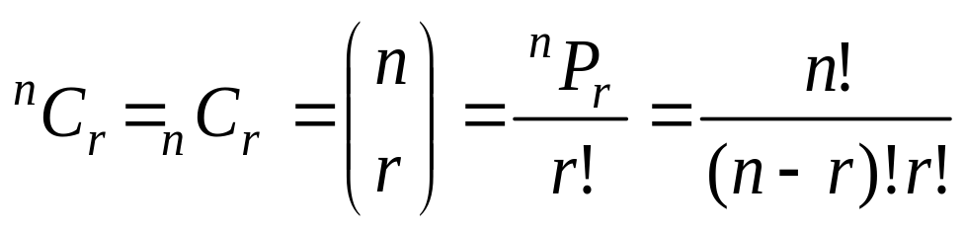

Combinations
A combination is a set of objects in which order is not important.
Example, AB = BA
The formula:
Given 3 people, Bob, Mike and Sue, how many different ways can these three people be arranged where order does not matters?
Since order does not matter, any arrangement with Bob, Mike and Sue is considered the same arrangement.
Therefore the only arrangement is BMS.

Slide 3
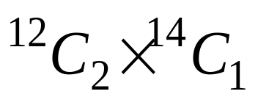
Combinations
There are 12 boys and 14 girls in Mrs. Lee’s Math
class. Find the number of ways Mrs. Lee can select a
team of 3 students from the class to work on a group
project. The team consists of 1 girl and 2 boys.
Solution:
Number of ways =
= 924

Slide 4
Exercise
3) Five students are chosen from a class of 12 male students and 8 female students to represent the class in a Mathematics Quiz. Calculate
(a) the number of ways in which the five students can be chosen
The number of ways in which the five students can be chosen if three of the representatives must be male students.
The number of ways of choosing the students if at least three of the representatives must be female students.

Slide 5
Exercise
In an examination, other than Malay and English language, each candidate has to take 5 other subjects from two groups of subjects as shown in the following table.
Find the number of choices that a student has if he takes:
Three science subjects
Not more than two arts subjects
Science subjects | Arts subjects
Physics Chemistry Mathematics Biology | History Geography Economics Psychology

